Slide 1
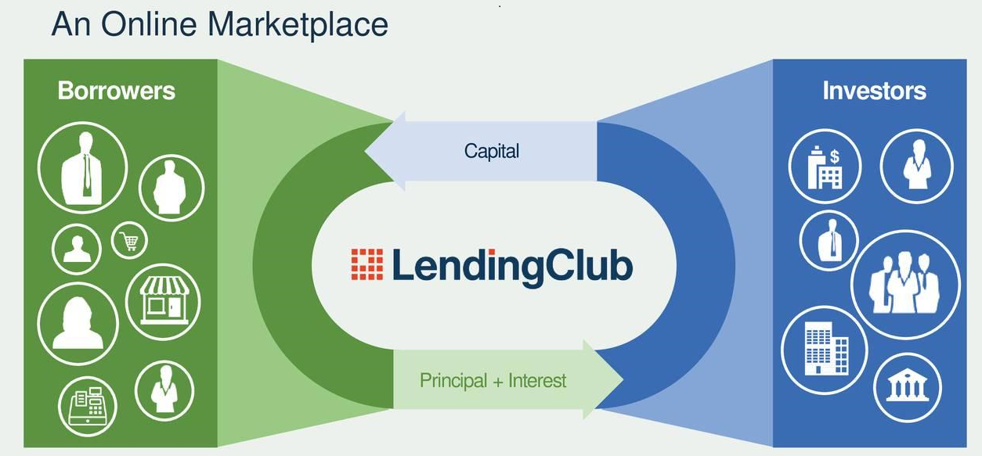
Naveen Kumar Saharan
Shweta Singh

Slide 2
Lending Club Case study – Executive Summary
Business Understanding
Consumer finance company Lending Club which specializes in lending various types of loans to urban customers. Borrowers can easily access lower interest rate loans through a fast online interface.
Approach
Data cleaning Univariate analysis Segment analysis Bivariate analysis Correlation analysis Derived Metrics ----------------------------------------------------------------------------------
Key Take Aways
Understand consumer attributes and loan attributes how it influence the tendency of default Recommendation of important variables
Univariate Analysis | Categorical variable are analysed – group, sub group, loan status, state, verification status, etc Bar plot used
 | Continuous variable are analysed – amount , DTI, interest rate, etc Box plot, histogram, distribution plot used.
Key objectives
Lending Club wants to understand the driving factors behind loan default, i.e. the driver variables which are strong indicators of default. The company can utilize this knowledge for its portfolio and risk assessment.
Bivariate and Segmented Analysis | Categorical variable are plotted against categorical variables to gain more information Eg. State vs Loan Status, purpose vs Loan Status
 | Continuous variable are plotted against categorical variables to gain more information Eg. Loan amount vs Grades, Continuous variable plotted against continuous variable – charged off percent vs interest rate, loan amount vs annual income

Slide 3
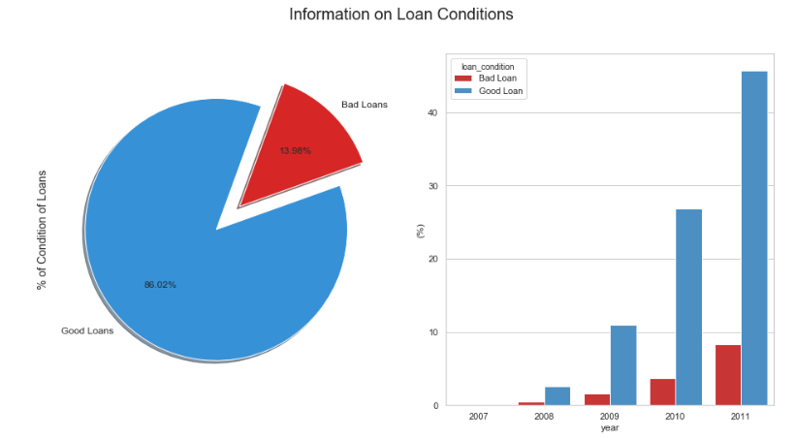
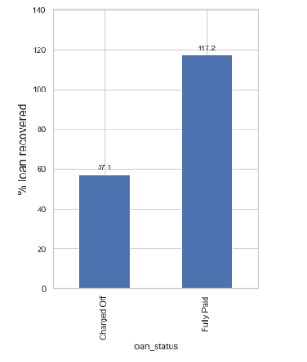
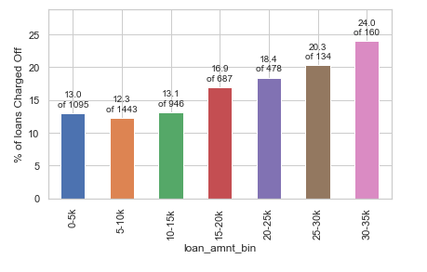
Analysis – Loan Amount and Loan Status
Company has 14% bad loans
Lending club recovers 57% loans defaulted
% charged off loan increased as loan amount increases
Company makes 17% profit on Fully paid loans

Slide 4
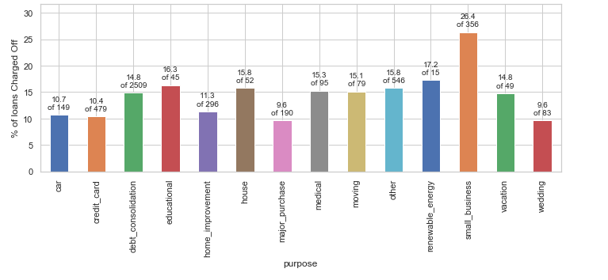
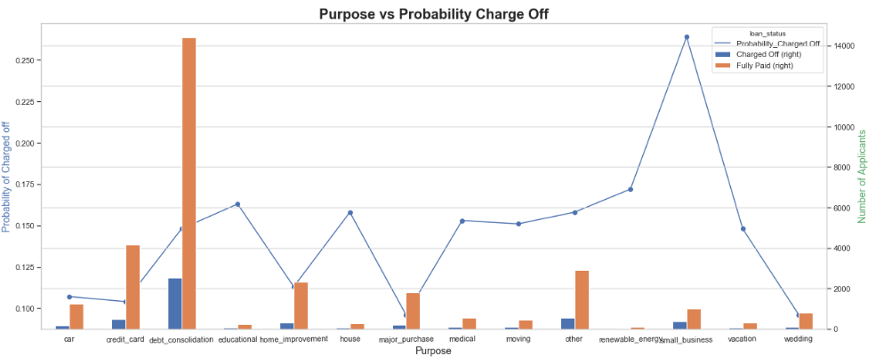
Analysis – Purpose vs Charged off
Small Business highest % of charged off loans – Most risky Category in Purpose

Slide 5
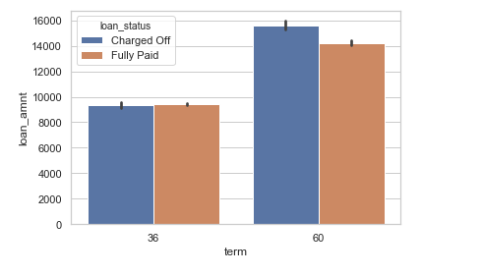
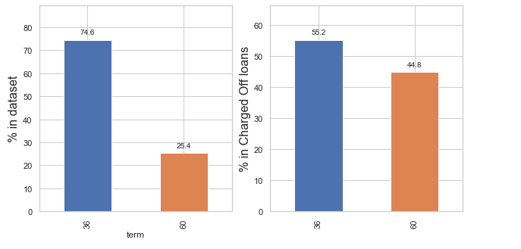
Analysis – Loan Term vs Charged off
Maximum loan is given for 36 months, but the % of charged off for 60 months is almost same; Higher loan amount are associated with longer terms and see higher Charge Offs.

Slide 6
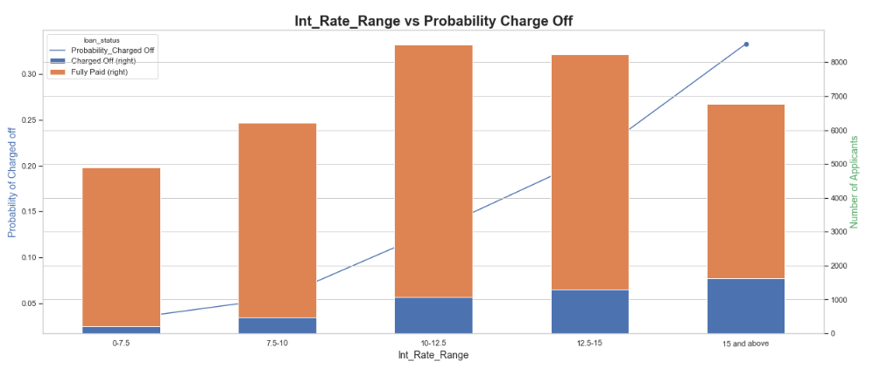
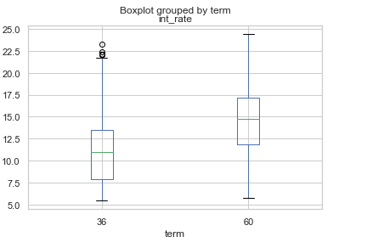
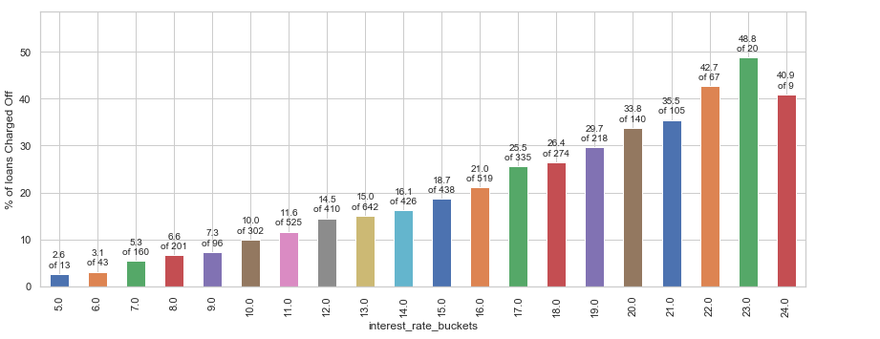
Analysis – Interest Rate vs Charged off
Interest rate Varies from 5.4 % to 24% Int. rate for charged off loans appear to be higher Higher rate of interest for longer term of loan Risk increases as rate of interest increases along with Loan term.

Slide 7
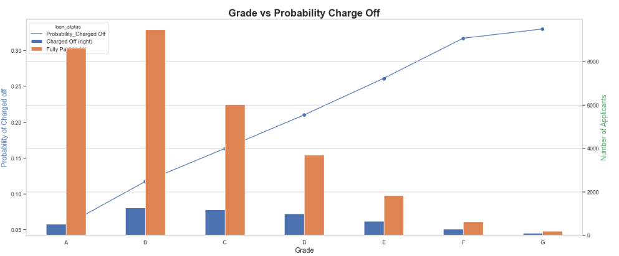
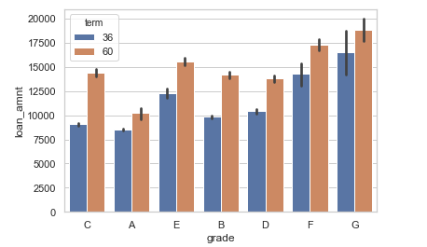
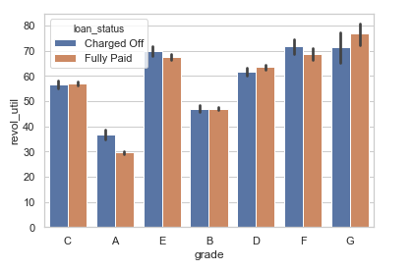
Analysis – Interest Rate, Revol_util, Term vs Charged off
Higher loan amount are associated with lower grade for longer terms revol_util and grade are positively correlated Higher loan amount, for lower grade for longer term are High risk Business.

Slide 8
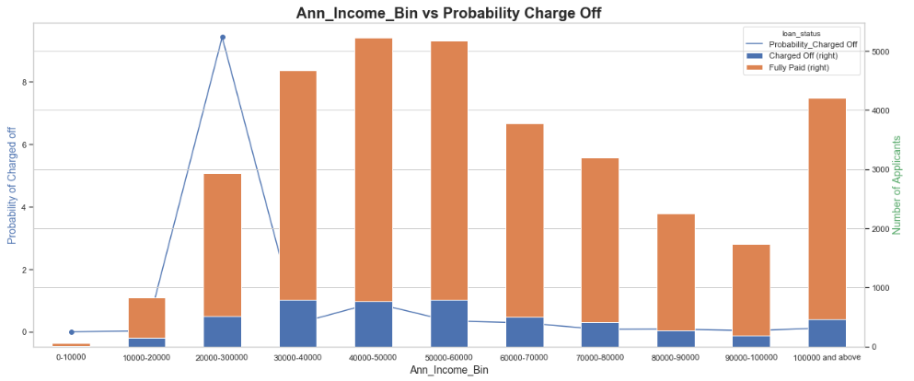
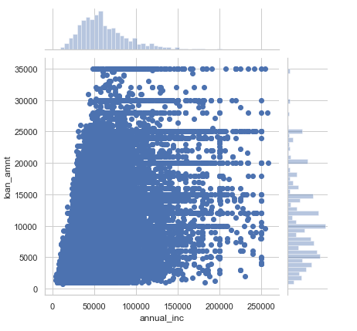
Analysis –Annual Income vs Charged off
% charged off is more in Lower income group, Analysis also shows Median annual income is around 60,000. People with average income lower than 50000 taking loans of 25000 or higher. These would be risky loans.

Slide 9
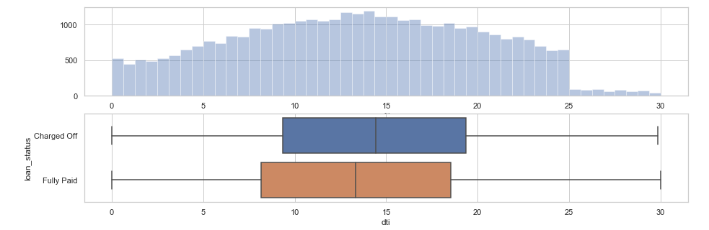
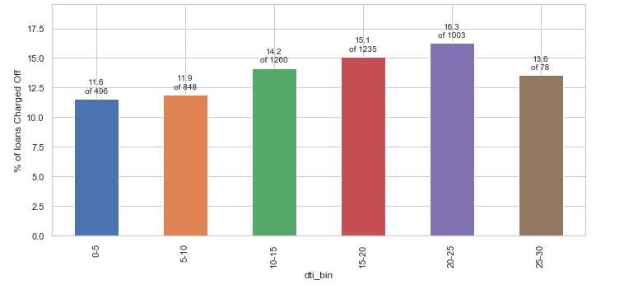
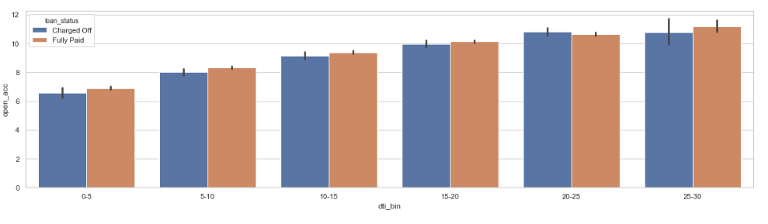
Analysis –Debt to Income Ratio vs Charged off
When the dti or dept payment to income ratio is higher than 20, higher percentage of loans are Charged Off The dti increases with the number of open credit line in borrowers credit file Higher the dti higher the chances of loan being Charged Off

Slide 10
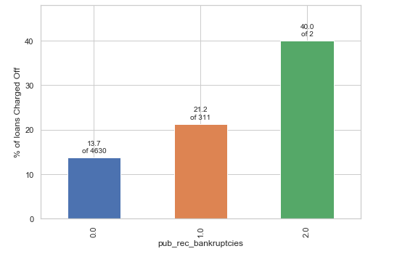
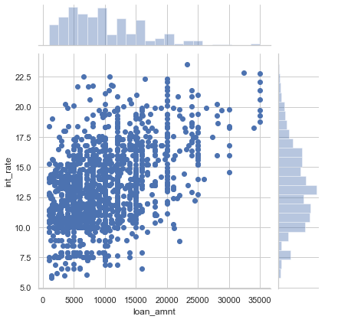
Analysis –Bankcruptcies vs Charged off
pub_rec_bankruptcies > 0
High chance of getting default for questionable record

Slide 11
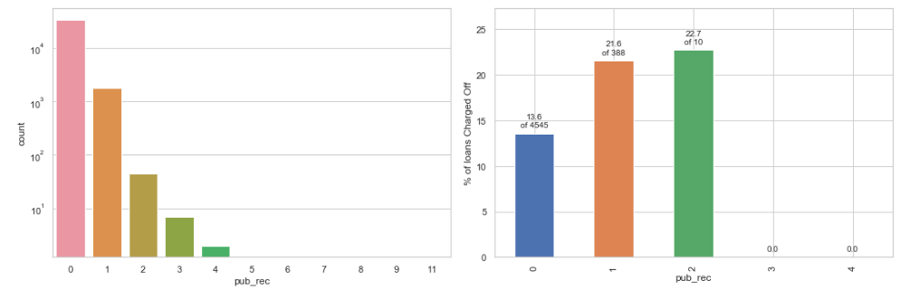
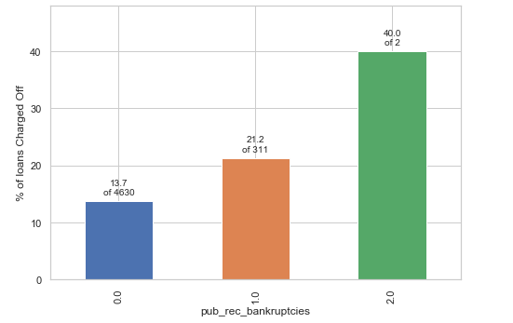
Analysis –Defaults by prior bad record
94% have no Public derogatory records, but 1 derogatory record increases the chances of Charge Off
96% have no bankruptcy record, even 1 bankruptcy record increases the chances of Charge Off
Public Derogatory Record and Public Bankruptcy records have 83% Correlation, we can use one of these.

Slide 12
Conclusion –Major Factors for Default loans
Purpose of Loan
Annual Income
Debt to income ratio
Grade
Interest Rate
Term
RISK Factors
Suggestion
Don’t approve where purpose is small business
Stop approving loan with DTI > 30%
Charge higher interest rate when with DTI > 20%
Don’t approve loan to lower income group applying for high amount of loan
Don’t approve loan high DTI applying for long term
Don’t approve high loan amount to questionable borrowers

Slide 13
Other observations
Variables which may add up to applicant profile who tend to default
Employee length <=2
Verification status - Unverified
Loans default on high instalment
Delinq 2 yrs
Variables with very less or no impact
Emp title
Home ownership
Variable to drop for ML modelling
High correlated variables
Variables not available at time of application

Slide 14
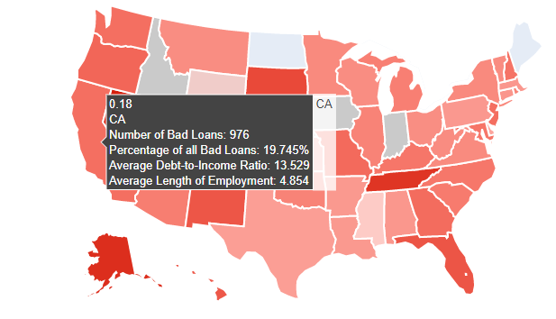
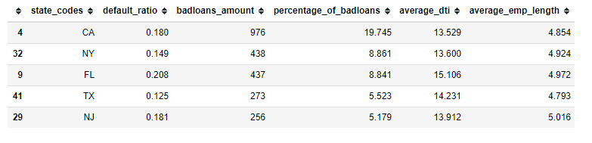
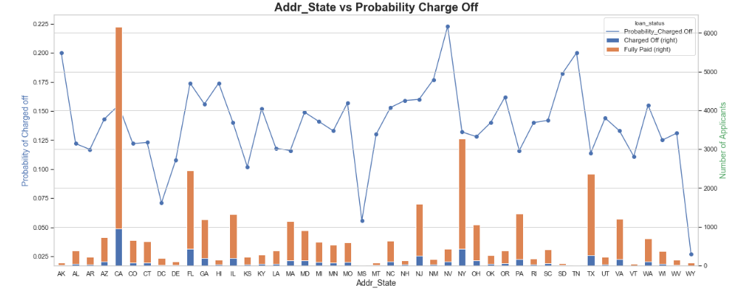
Interesting tidbits - Analysis –State vs Charged off
Highest number of loan issued to CA Max % of bad loan is in CA Address state – CA, NY FL with high rate of interest and high loan amount tend to default

